Slide 1

SPIDERBOT
A 12-DOF Quadrupedal Robot • Final Project Presentation

Slide 2
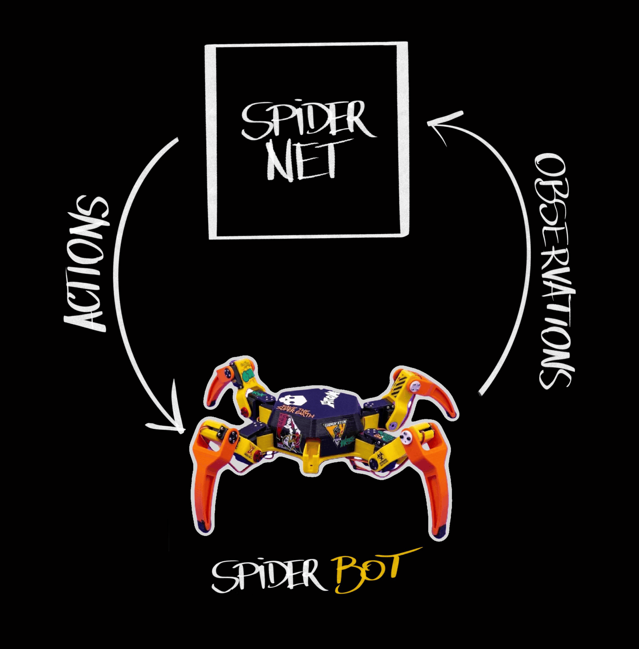
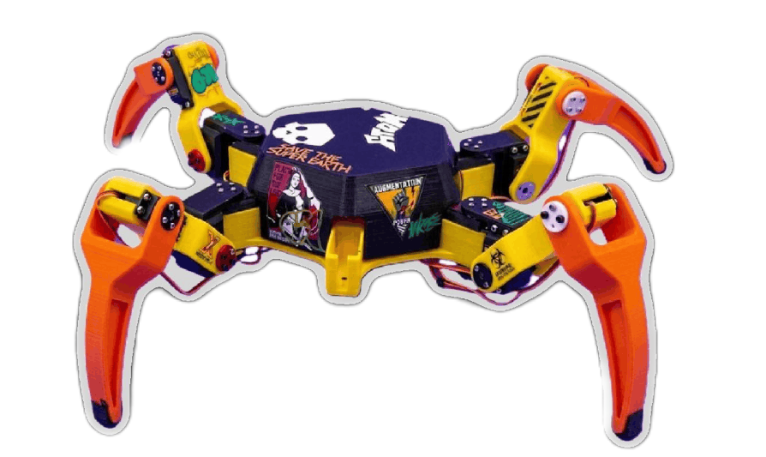
INTRODUCTION & ROBOT MODEL
SpiderBot is a 12-DOF spider-like robot featuring four legs, with three actuated revolute joints per leg.
▹
Hexagonal main body geometry
▹
Coxa, Femur, and Tibia links
▹
Eye-catching street design

Slide 3
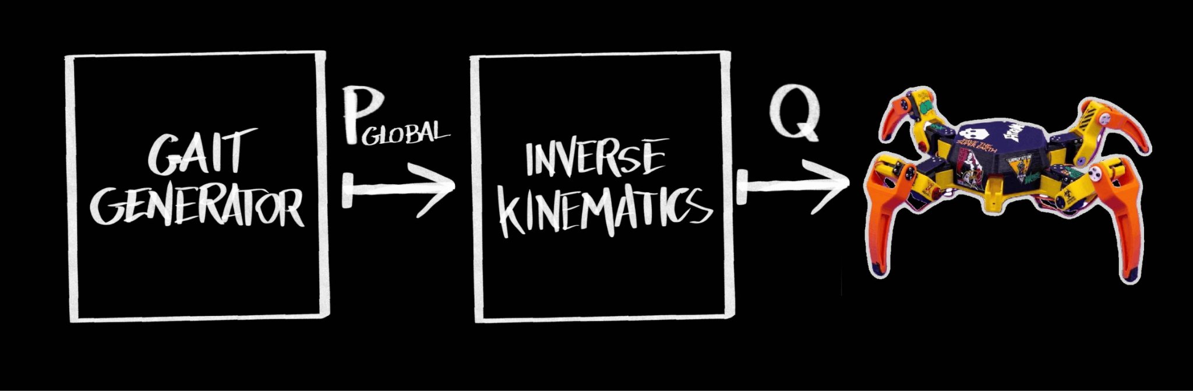
OPEN LOOP KINEMATIC CONTROL
High-level time-driven trajectory planner. Computes desired 3D Cartesian coordinates of each foot relative to the robot's reference frame.
Mid-level spatial transformation layer. Translates optimal 3D footprints into precise joint angle requirements.
Low-level actuation of joints.
Digital twin simulation from given joint commands.

Slide 4


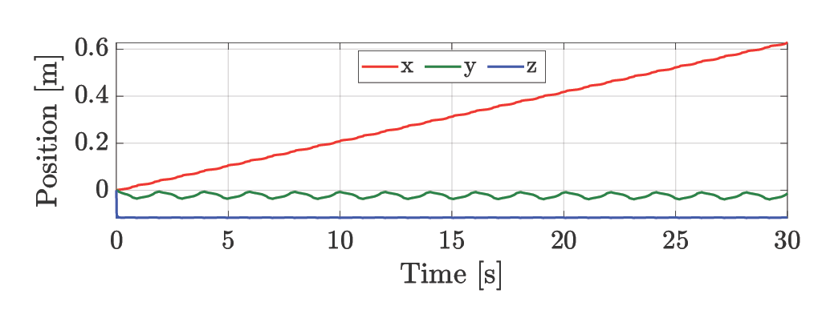
IMPLEMENTED LOCOMOTION GAITS (I)
Creep Gait
A 4-beat walking gait designed for maximum stability on uneven terrain.
▹
Foot Scheduling: [0 25 50 75]
▹
Cycle duration: T = 2 s
▹
Command: dir_x = 1.0

Slide 5

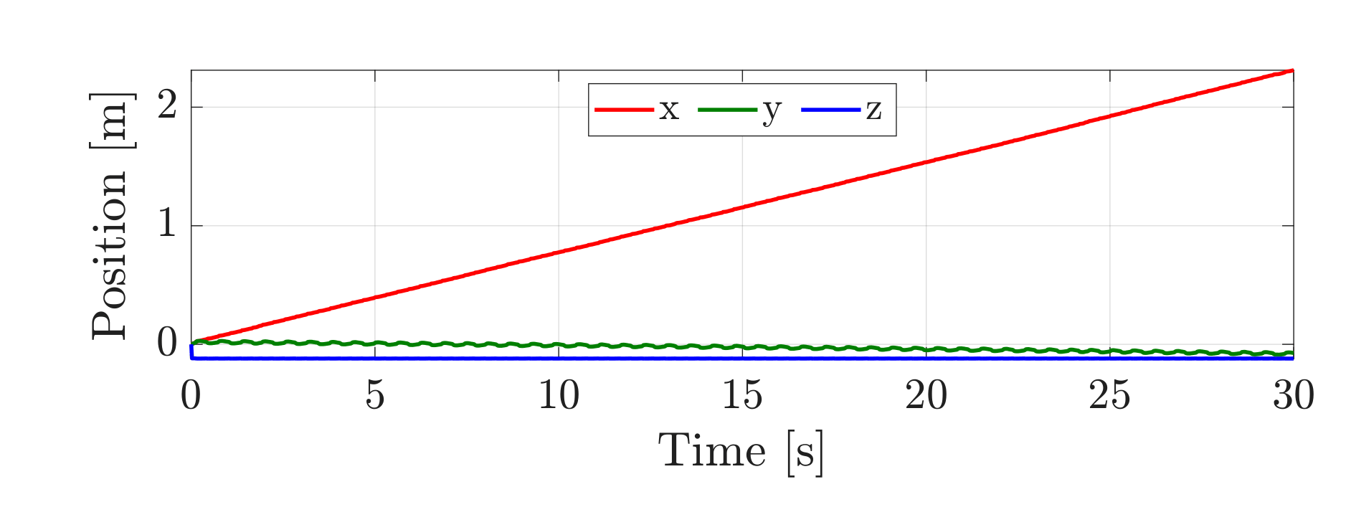
IMPLEMENTED LOCOMOTION GAITS (I)
Trot Gait
A medium-to-high-speed 2-beat gait synchronizing diagonal pairs.
▹
Foot Scheduling: [0 50 50 0]
▹
Cycle duration: T = 0.6 s
▹
Command: dir_x = 1.0

Slide 6
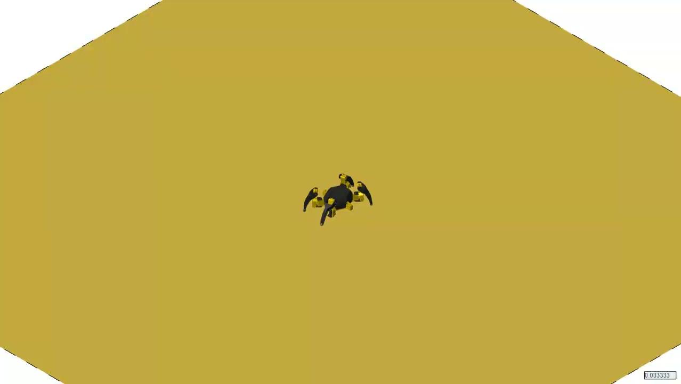

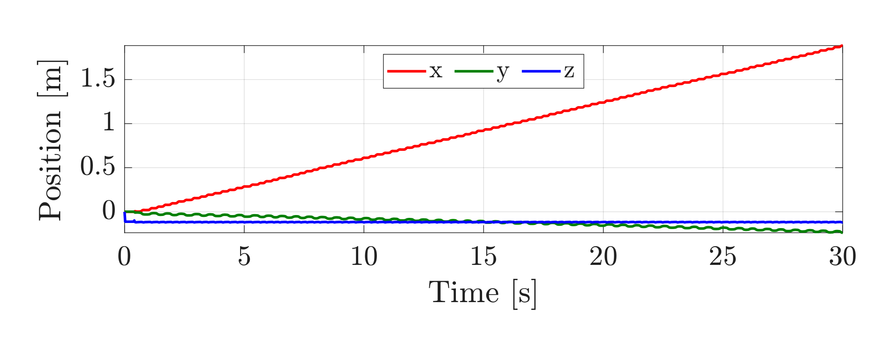
IMPLEMENTED LOCOMOTION GAITS (II)
Pace Gait
A lateral 2-beat gait moving legs on the same side simultaneously.
▹
Foot Scheduling: [0 50 0 50]
▹
Cycle duration: T = 0.6 s
▹
Command: dir_x = 1.0

Slide 7

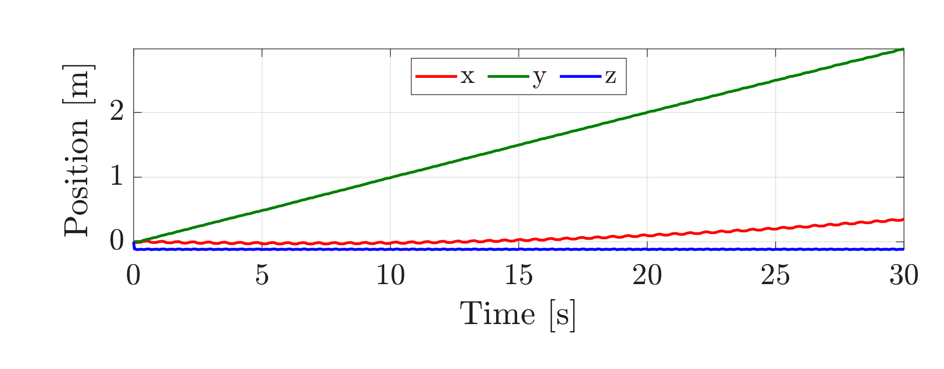
IMPLEMENTED LOCOMOTION GAITS (II)
Gallop Gait
A highly dynamic 4-beat bounding gait with major biomechanical upgrades.
▹
Foot Scheduling: [0 10 50 60]
▹
Cycle duration: T = 0.6 s
▹
Command: dir_y = 1.0

Slide 8
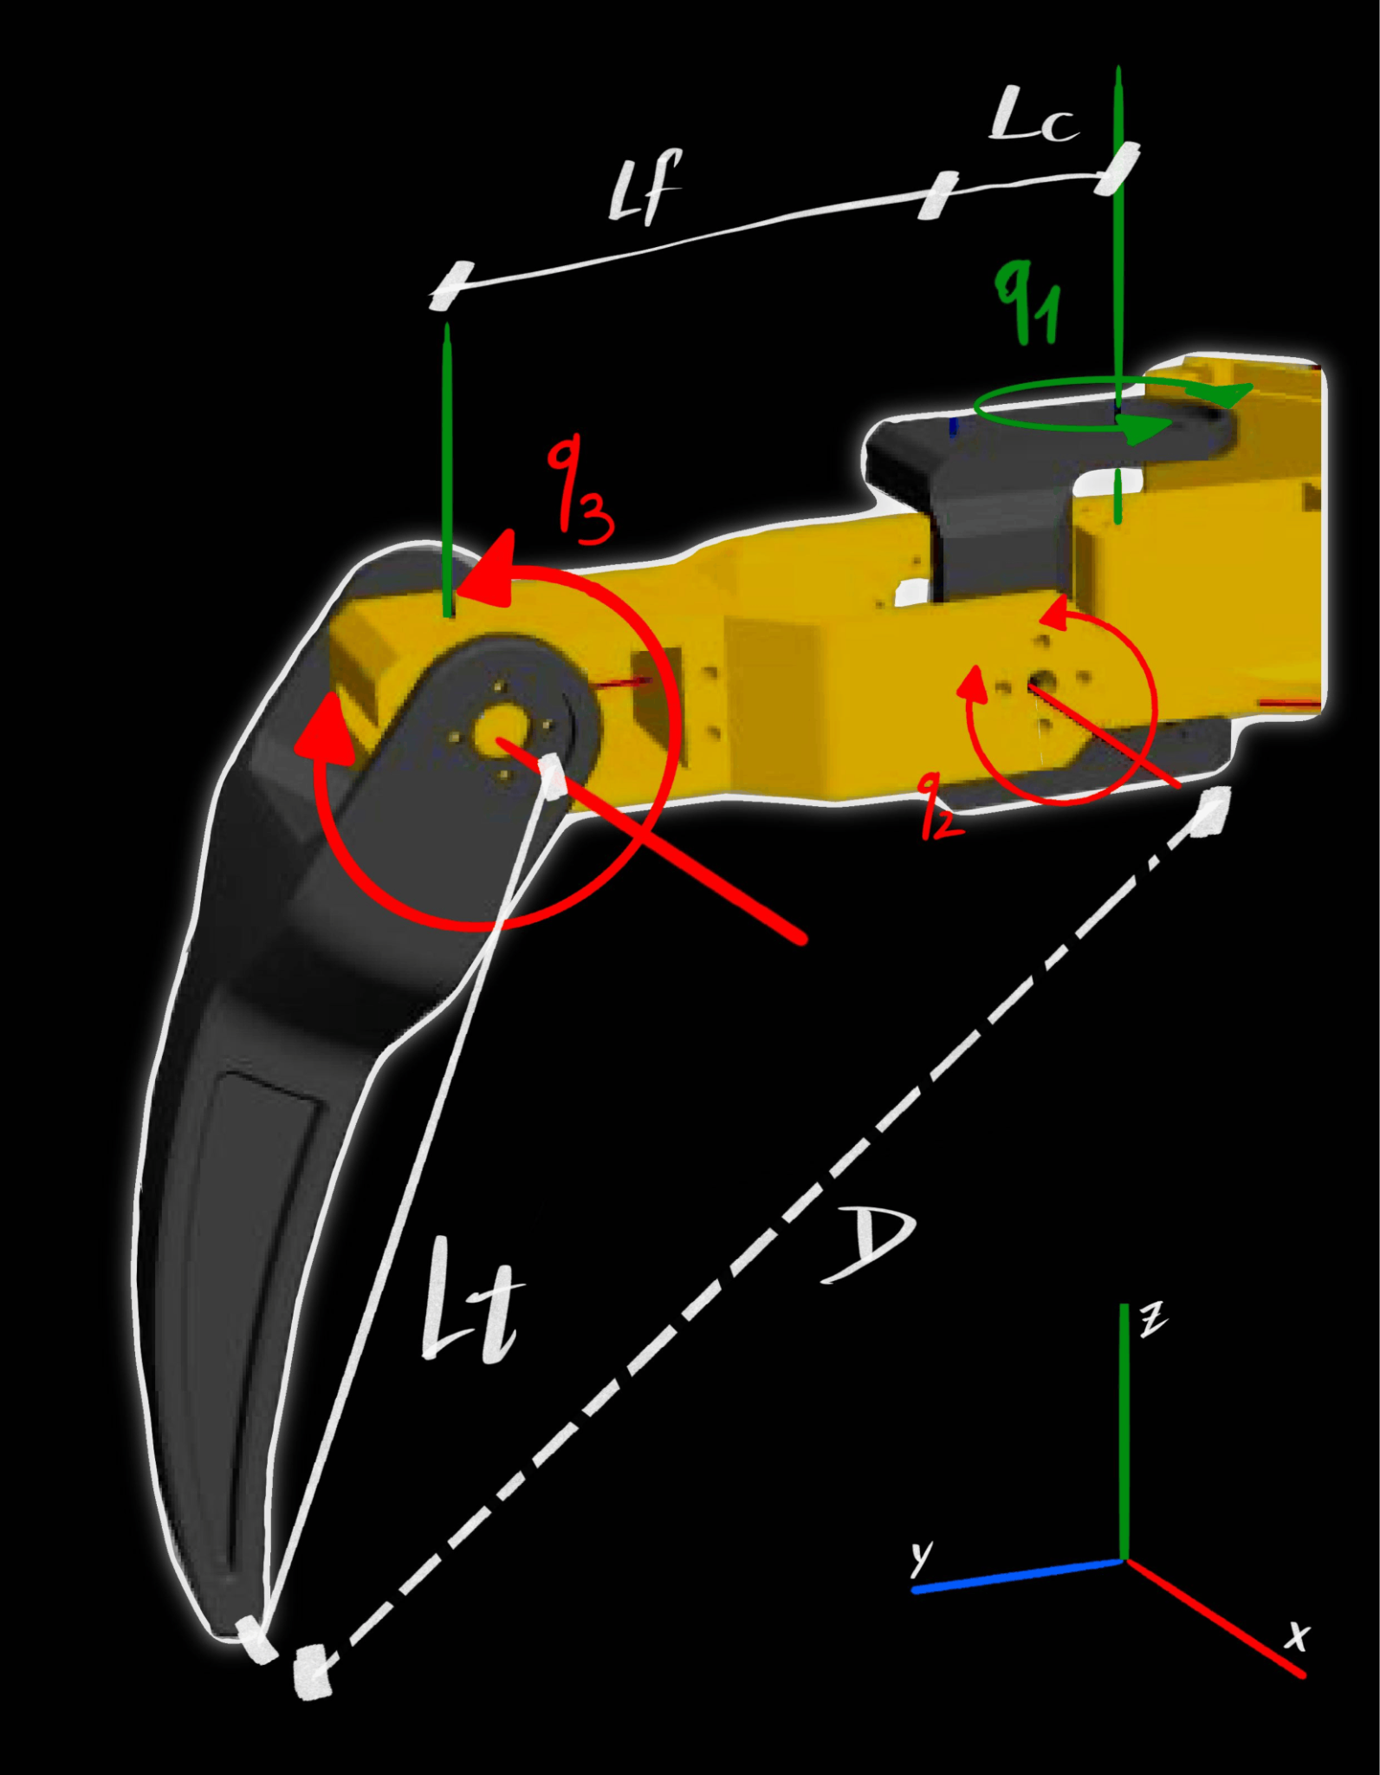
INVERSE KINEMATICS MAPPING
Cartesian to Joint Space
The system translates Cartesian foot coordinates into physical actuator commands using an analytical IK solver for 3-DOF legs.
Target coordinates are rotated into the local 2D working plane of the leg. The Coxa angle (q1) is derived via planar trigonometry:
q₁ = atan2(y_loc, x_loc)
The Femur and Tibia angles are subsequently solved using distance projections and the Law of Cosines.
q₃ = arccos((D² - L_f² - L_t²) / (2 L_f L_t))
q₂ = atan2(z_loc, L_fwd) + atan2(L_t sin(q₃), L_f + L_t cos(q₃))

Slide 9
END-TO-END DRL CONTROL
THE SPIDERNET
▹
Z-height
▹
Chassis orientation quaternion
▹
12 Angular Positions
▹
12 Velocities
Deep Reinforcement Learning
Transitioning from geometric trajectory planning, this architecture employs End-to-End Deep Reinforcement Learning.
A deep neural network acts as the singular controller, learning a direct mapping from the robot's proprioceptive sensory inputs to raw joint-level actuation commands.
Framed as a Markov Decision Process (MDP), the agent interacts with the MuJoCo physics engine to maximize expected cumulative reward.
▹
12 Angular Positions

Slide 10

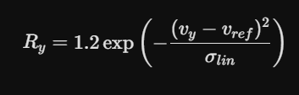

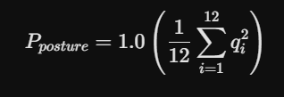
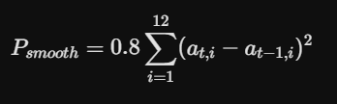
REWARD FUNCTION OPTIMIZATION
track_changes Target Velocity Tracking
Incentivizes tracking exactly v_ref = 1.0 m/s using a bounded Gaussian function. Prevents "runaway sprint" exploitation.
block Orthogonal Drift Penalty
Symmetrically punishes any deviation along the X-axis. The 0.3 weight suppresses forward walking while allowing balance micro-adjustments.
accessibility_new Aggressive Posture Penalty
Applies a heavily weighted MSE penalty to joint angles. Forces an energy-efficient pose, preventing strained, splayed stances.
waves Strict Actuator Smoothness
Penalizes the action jerk. Coerces smooth, sinusoidal-like signals to protect physical servo gears from mechanical fatigue.

Slide 11
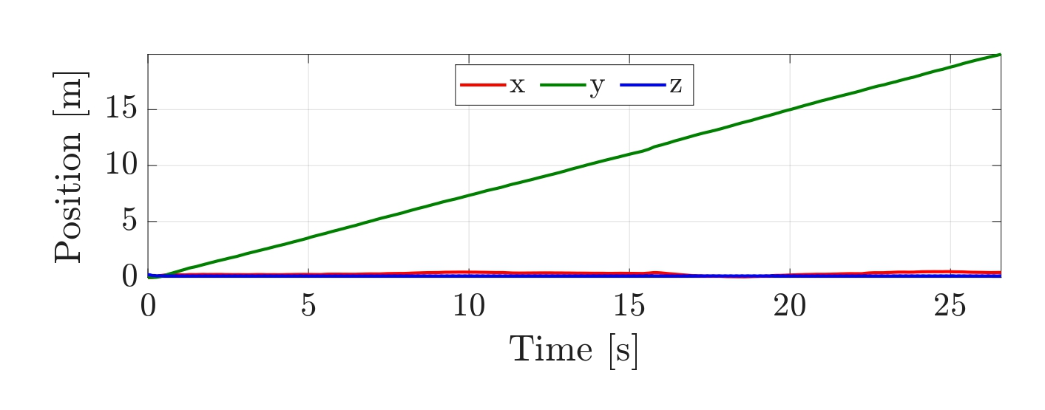
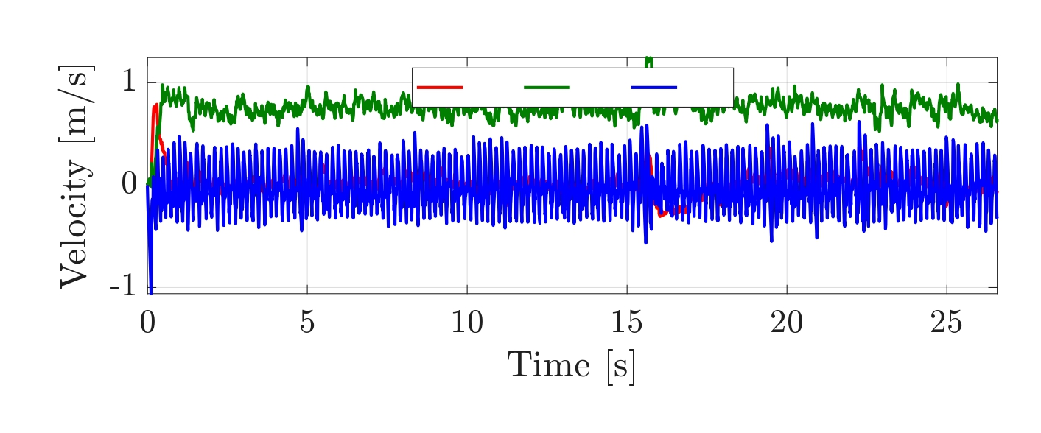
LEARNING RESULTS
Position Dynamics
▹
Perfect Lateral Tracking: The y-position (green) climbs steadily to ~18m, proving continuous, uninterrupted locomotion.
▹
Zero Forward Drift: The x-position (red) remains perfectly flat, confirming the Neural Network successfully learned to avoid the 0.3|v_x| drift penalty.
Velocity Profile
▹
Gaussian Target Optimization: Lateral velocity v_y (green) stabilizes around 0.8 m/s, showing the agent optimized the squared-exponential tracking reward.
▹
Emergent Stepping Rhythm: The high-frequency oscillations on the z-velocity (blue) represent the continuous footfall impacts of the policy's self-taught ambling gait.

Slide 12
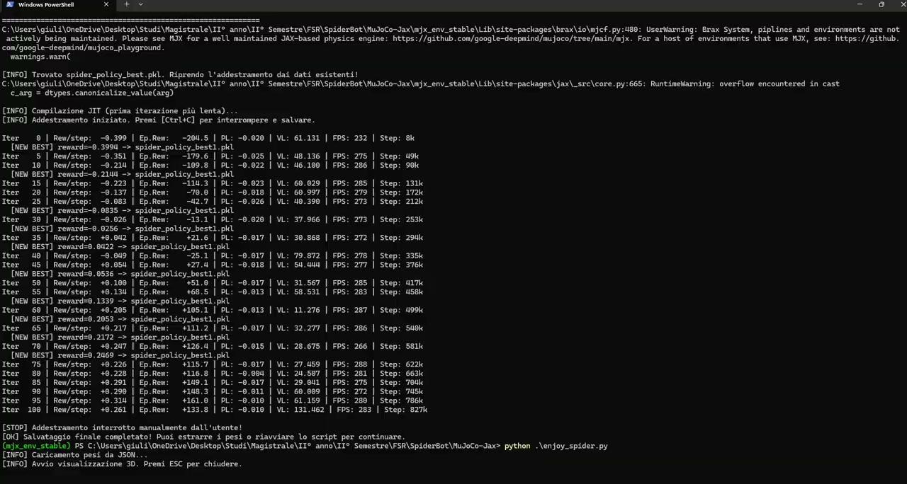

Slide 13
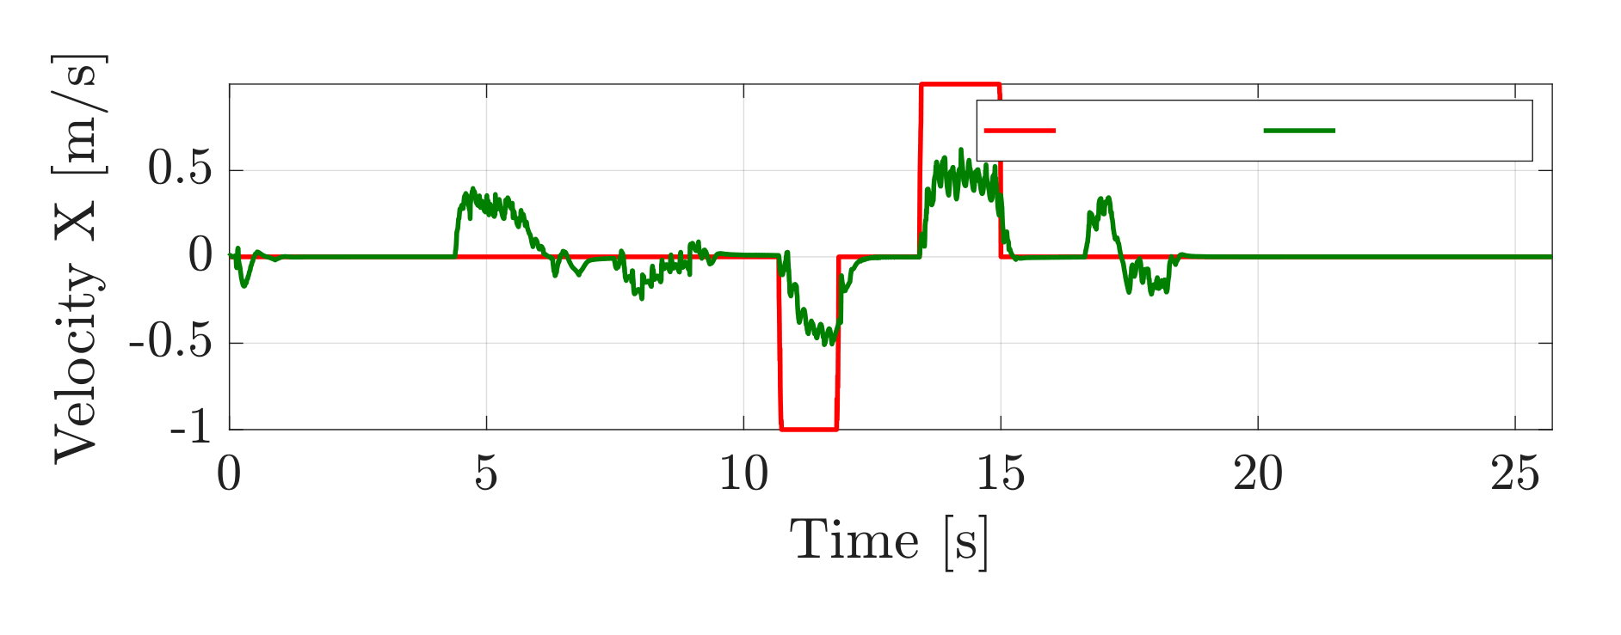

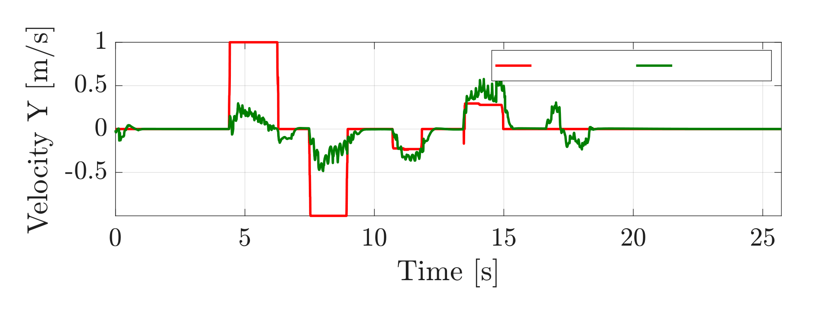

TELEOPERATED LEARNING
Furthermore, we implemented a different learning approach: instead of tracking a fixed velocity reference on the y-axis, it learns to follow variable references on both axes.
The objective function was modified; specifically, the tracking reward is defined as:
While the drift penalty is given by:

Slide 14
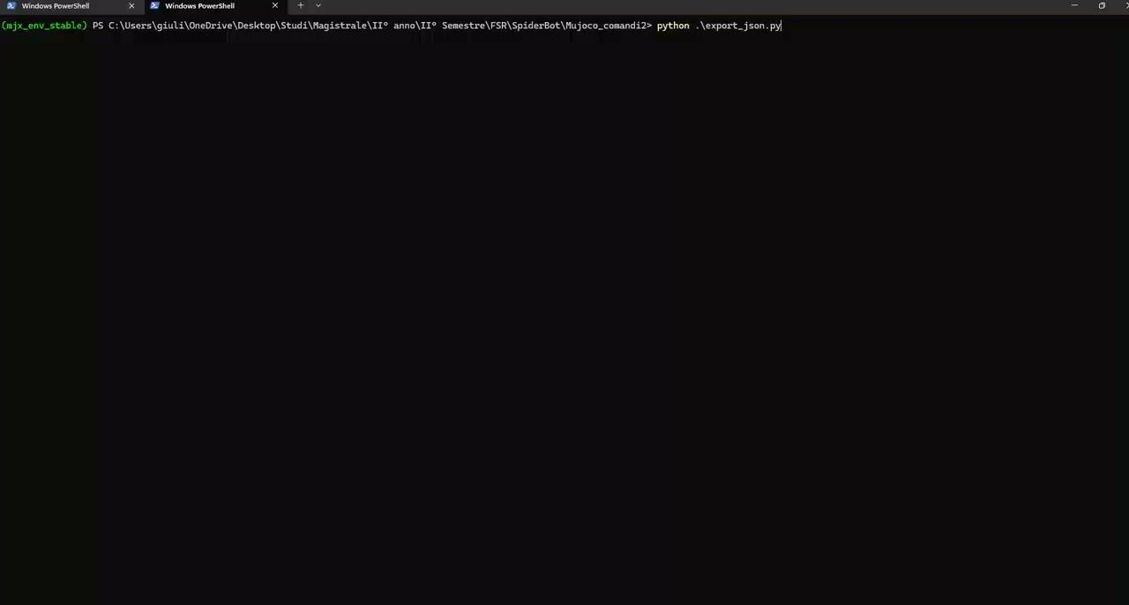

Slide 15
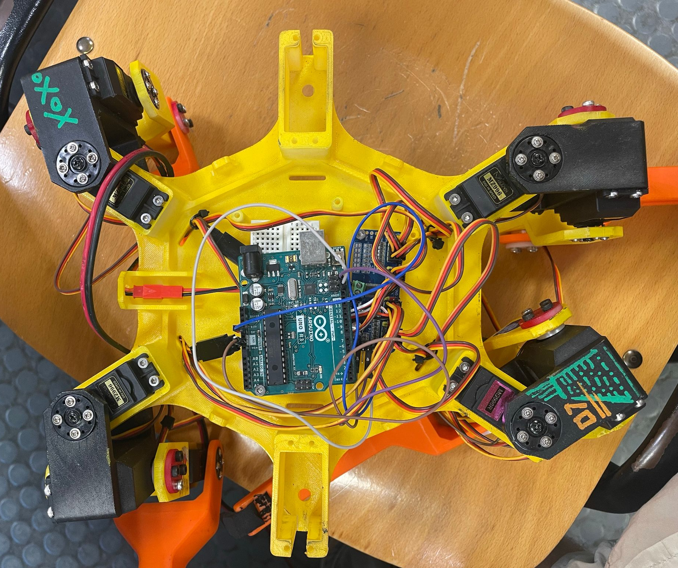
HARDWARE IMPLEMENTATION
Electronic Architecture
The system utilizes a master-slave topology. An external host streams high-level commands, while the local MCU calculates the Inverse Kinematics.
▹
Arduino MCU: Read serial data, calculates gait phases, and runs IK geometry math.
▹
PCA9685 PWM Driver: Offloads PWM generation via I2C to precisely control 12 MZ996R servos without saturating MCU timers.
▹
Structure: Manufactured via FDM 3D Printing (PLA) adhering exactly to the URDF link dimensions.

Slide 16
Final Ride
https://github.com/GV-ing/SpiderBot.git
THANK YOU FOR YOUR ATTENTION

